Slide 1
Weekly Progress Report 18-22 August 2025
Kushagra Agrawal

Slide 2
MATLAB + DAQ Data Acquisition
Components for EMG Data Acquisition
1. EMG Sensor
Function: Measures electrical activity from muscles.
Placement: Electrodes on muscle belly, along muscle, and reference on a neutral area (backside of hand in our case).
Output: Analog voltage signal.
2. NI DAQ USB-6001 (or NI MyDAQ)
Function: Analog-to-Digital Converter (ADC).
Connection: Receives analog signal from the circuit, connects to PC via USB.
Role: Converts continuous analog signal into discrete digital data.

Slide 3
MATLAB + DAQ Data Acquisition
Software Requirements :
MATLAB
MATLAB Data Acquisition Toolbox
NI USB Drivers

Slide 4
MATLAB Script Overview
Key Parameters :
Setting Up the Collection Environment
Gesture & Timing:
gestureNames: {'Rest', 'Fist', 'Open Hand', 'Pinch', 'Wave’}
numRepetitions: 5 per gesture
gestureDuration: 3 seconds
restDuration: 2 seconds
DAQ Settings:
deviceID: 'Dev1’
channelID: 'ai0’
sampleRate: 1000 Hz

Slide 5
MATLAB Script Overview
Key Parameters :
Setting Up the Collection Environment
Filter Cutoffs:
highpassCutoff: 20 Hz
notchFreq: 60 Hz
envelopeCutoff: 5 Hz
Feature Extraction Windows:
windowSize: 0.2 seconds
windowOverlap: 0.1 seconds
Notes:
20-500 Hz in EMG ! Filter cutoffs

Slide 6
MATLAB Script Overview
config = struct();
config.deviceID = 'Dev1'; % NI DAQ device ID
config.channelID = 'ai0'; % Analog input channel
config.sampleRate = 1000; % Hz - sampling frequency
config.gestureNames = {'Rest', 'Fist', 'Open Hand', 'Pinch', 'Wave'};
config.numRepetitions = 5; % Repetitions per gesture
config.gestureDuration = 3; % seconds per gesture
config.restDuration = 2; % seconds rest between gestures
config.windowSize = 0.2; % seconds - feature extraction window
config.windowOverlap = 0.1; % seconds - overlap between windows
% Filter parameters
config.highpassCutoff = 20; % Hz - remove baseline wander
config.notchFreq = 60; % Hz - power line interference (50 or 60)
config.notchBandwidth = 2; % Hz - notch filter bandwidth
config.envelopeCutoff = 5; % Hz - envelope extraction
This part of the code sets the parameters as discussed in the previous slides

Slide 7
MATLAB Script Overview
try
dq = daq("ni");
ch = addinput(dq, config.deviceID, config.channelID, "Voltage");
ch.Range = [-10, 10]; % Voltage range for USB-6001
dq.Rate = config.sampleRate;
fprintf('✓ DAQ initialized successfully\n');
catch ME
error('Failed to initialize DAQ: %s', ME.message);
end
This part of the code initialized the session with DAQ and reserves the DAQ for utilization by MATLAB at that time

Slide 8
MATLAB Script Overview
This part of the code designs the filters required for the data acquisition as describes in slide 6. This is an internal function call to MATLAB Singal Processing Module
filters = designFilters(config);

Slide 9
MATLAB Script Overview
allFeatures = [];
allLabels = [];
acquisitionInfo = struct();
acquisitionInfo.config = config;
acquisitionInfo.timestamp = datetime('now');
acquisitionInfo.filterInfo = filters.info;
Defines array and data that needs to be captured and saved as a dataset

Slide 10
MATLAB Script Overview
%% Main Data Collection Loop
fprintf('\n=== Starting Data Collection ===\n');
fprintf('Total gestures: %d, Repetitions each: %d\n', ...
length(config.gestureNames), config.numRepetitions);
gestureCount = 0;
totalGestures = length(config.gestureNames) * config.numRepetitions;
for gestureIdx = 1:length(config.gestureNames)
gestureName = config.gestureNames{gestureIdx};
for rep = 1:config.numRepetitions
gestureCount = gestureCount + 1;
fprintf('\n--- Gesture %d/%d: %s (Rep %d) ---\n', ...
gestureCount, totalGestures, gestureName, rep);
% Rest period with countdown
fprintf('Rest period... ');
for i = config.restDuration:-1:1
fprintf('%d ', i);
pause(1);
end
fprintf('\n');
% Gesture acquisition
fprintf('Perform gesture: %s\n', gestureName);
[rawData, features, labels] = acquireGesture(dq, config, filters, ...
gestureName, gestureIdx);
% Store data
allFeatures = [allFeatures; features];
allLabels = [allLabels; labels];
fprintf('✓ Collected %d feature windows\n', size(features, 1));
end
end
Main Data Collection Loop – It has print statements too. So that we know when to collect the data and when not to collect the data. When to do which gesture

Slide 11
MATLAB Script Overview
%% Save Dataset
timestamp = datestr(now, 'yyyymmdd_HHMMSS');
filename = sprintf('EMG_Dataset_%s.mat', timestamp);
% Prepare final dataset structure
dataset = struct();
dataset.X = allFeatures; % Feature matrix (N x features)
dataset.Y = allLabels; % Labels (N x 1)
dataset.gestureNames = config.gestureNames; % Gesture name mapping
dataset.featureNames = {'MAV', 'RMS'}; % Feature names
dataset.acquisitionInfo = acquisitionInfo; % All metadata
save(filename, 'dataset');
fprintf('\n✓ Dataset saved as: %s\n', filename);
fprintf('Total samples collected: %d\n', length(allLabels));
fprintf('Features per sample: %d\n', size(allFeatures, 2));
Dataset Saving Logic for further model training

Slide 12
MATLAB Script Overview
%% Save Dataset
timestamp = datestr(now, 'yyyymmdd_HHMMSS');
filename = sprintf('EMG_Dataset_%s.mat', timestamp);
% Prepare final dataset structure
dataset = struct();
dataset.X = allFeatures; % Feature matrix (N x features)
dataset.Y = allLabels; % Labels (N x 1)
dataset.gestureNames = config.gestureNames; % Gesture name mapping
dataset.featureNames = {'MAV', 'RMS'}; % Feature names
dataset.acquisitionInfo = acquisitionInfo; % All metadata
save(filename, 'dataset');
fprintf('\n✓ Dataset saved as: %s\n', filename);
fprintf('Total samples collected: %d\n', length(allLabels));
fprintf('Features per sample: %d\n', size(allFeatures, 2));
Dataset Saving Logic for further model training

Slide 13
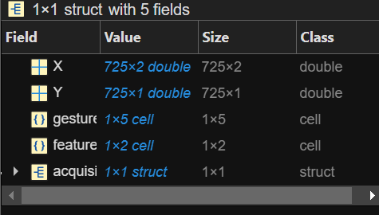
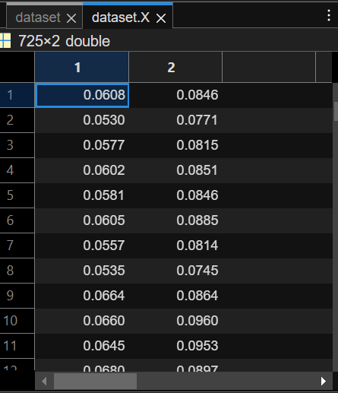
Saved Dataset
Captured Features : MAV & RMS in sliding window

Slide 14
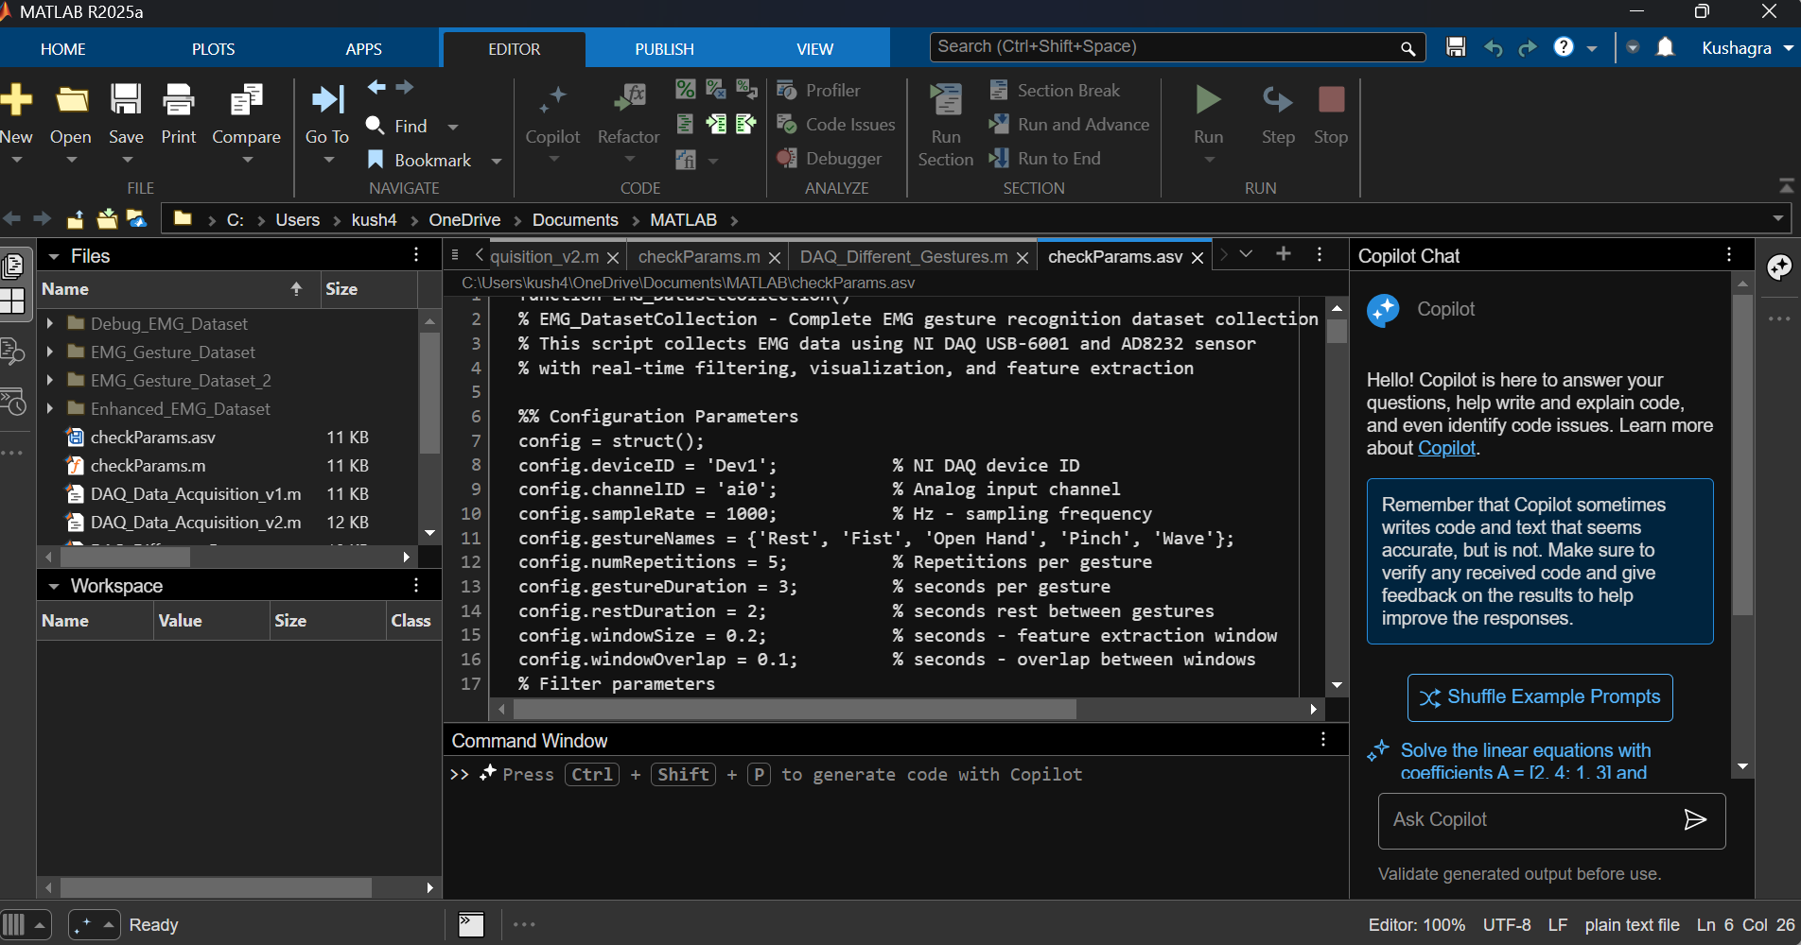
MATLAB + DAQ Data Acquisition

Slide 15
ESP-Now & Tiny ML Tutorial
Kushagra Agrawal

Slide 16
Requirements
Arduino IDE - https://www.arduino.cc/en/software/
Board Configurations for ESP-32
Libraries used
<WiFi.h>
<esp_now.h>

Slide 17
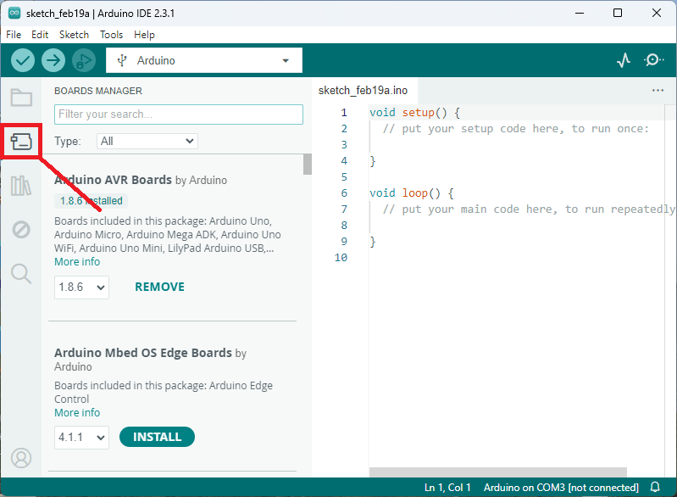
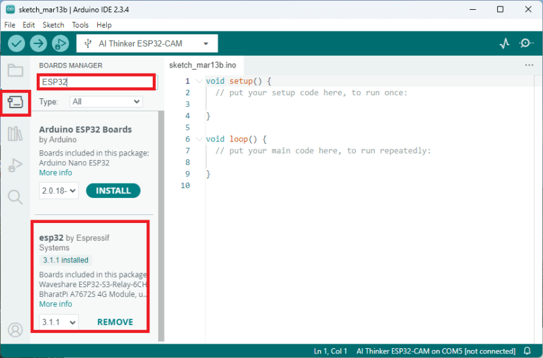
Downloading ESP-32 Boards
NOTE : Remember to download esp32 by Espressif Systems
https://randomnerdtutorials.com/installing-esp32-arduino-ide-2-0/

Slide 18
Downloading ESPTool
Make sure your system has Python 3.x version installed
Open a terminal and write
Once the installation is done try writing
It must be installed. ESPTool is an easy way to read a device MAC or flash memory on a device by Espressif
pip install esptool
esptool version
https://github.com/espressif/esptool

Slide 19
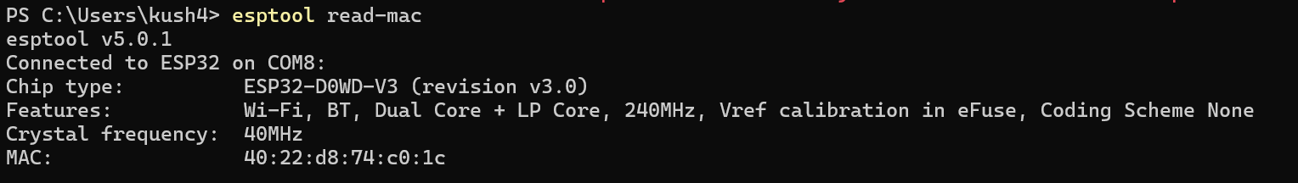
Reading MAC Address of ESP-32 Device
Make sure you have the ESPTool ready installed.
Plugin your device using a USB to Micro-USB Cable
Give the following command in the terminal
It will show an output like this :
Note Down the MAC Address Carefully
esptool read-mac

Slide 20
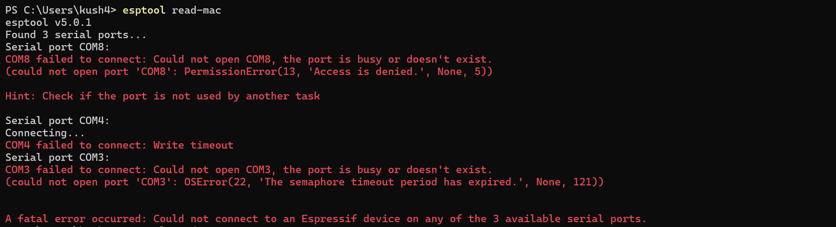
Debug Tip
If you get an error like this :
Close all the Arduino IDE Tabs or in the worst case – Restart the PC
If still encountering, you might have a chip not manufactured by Espressif

Slide 21

Coding 😵

Slide 22
Some Useful Functions
Function Name | Function Description
esp_now_init() | Initializes ESP-NOW. You must initialize Wi-Fi before initializing ESP-NOW.
esp_now_add_peer() | Call this function to pair a device and pass as an argument the peer MAC address.
esp_now_send() | Send data with ESP-NOW
esp_now_register_send_cb() | Register a callback function that is triggered upon sending data. When a message is sent, a function is called – this function returns whether the delivery was successful or not.
esp_now_register_recv_cb() | Register a callback function that is triggered upon receiving data. When data is received via ESP-NOW, a function is called.

Slide 23
Simple Program Analysis – Sender Side
#include <esp_now.h>
#include <WiFi.h>
uint8_t broadcastAddress[] = {0xFF, 0xFF, 0xFF, 0xFF, 0xFF, 0xFF};
typedef struct struct_message {
char a[32];
int b;
float c;
bool d;
} struct_message;
struct_message myData;
Line 1 – 2 : Include Libraries
Line 3 : Define Receiver MAC Address *
Line 4-9 : Defining a structure data type in C.
This defined the type and length of data you will be transmitting like here we are going to transmit character array of 32 length an int b and a float c and a bool variable d. These together as a group (wrapper) can be called struct_message
Line 10 : Intializes a variable ‘myData’ as the type ‘struct_message’
* Append 0x to each part of MAC Address Ex : If you chip MAC is 40:22:d8:74:c0:1c enter {0x40, 0x22, 0xd8, 0x74, 0xc0, 0x1c}

Slide 24
Simple Program Analysis – Sender Side (Contd.)
#include <esp_now.h>
#include <WiFi.h>
uint8_t broadcastAddress[] = {0xFF, 0xFF, 0xFF, 0xFF, 0xFF, 0xFF};
typedef struct struct_message {
char a[32];
int b;
float c;
bool d;
} struct_message;
struct_message myData;
Line 1 – 2 : Include Libraries
Line 3 : Define Receiver MAC Address *
Line 4-9 : Defining a structure data type in C.
This defined the type and length of data you will be transmitting like here we are going to transmit character array of 32 length an int b and a float c and a bool variable d. These together as a group (wrapper) can be called struct_message
Line 10 : Intializes a variable ‘myData’ as the type ‘struct_message’
* Append 0x to each part of MAC Address Ex : If you chip MAC is 40:22:d8:74:c0:1c enter {0x40, 0x22, 0xd8, 0x74, 0xc0, 0x1c}

Slide 25
Simple Program Analysis – Sender Side (Contd.)
esp_now_peer_info_t peerInfo;
void OnDataSent(const uint8_t *mac_addr, esp_now_send_status_t status) {
Serial.print("\r\nLast Packet Send Status:\t");
Serial.println(status == ESP_NOW_SEND_SUCCESS ? "Delivery Success" : "Delivery Fail"); }
This side code makes sure that the connection was established and the message was sent successfully from the sender side ESP32
void setup() {
Serial.begin(115200);
WiFi.mode(WIFI_STA);
if (esp_now_init() != ESP_OK) {
Serial.println("Error initializing ESP-NOW");
return;
}
The casual setup function to initialize things up

Slide 26
Simple Program Analysis – Sender Side (Contd.)
esp_now_peer_info_t peerInfo;
void OnDataSent(const uint8_t *mac_addr, esp_now_send_status_t status) {
Serial.print("\r\nLast Packet Send Status:\t");
Serial.println(status == ESP_NOW_SEND_SUCCESS ? "Delivery Success" : "Delivery Fail"); }
This side code makes sure that the connection was established and the message was sent successfully from the sender side ESP32
void setup() {
Serial.begin(115200);
WiFi.mode(WIFI_STA);
if (esp_now_init() != ESP_OK) {
Serial.println("Error initializing ESP-NOW");
return;
} ….
The casual setup function to initialize things up

Slide 27
Simple Program Analysis – Sender Side (Contd.)
void loop() {
strcpy(myData.a, "THIS IS A CHAR");
myData.b = random(1,20);
myData.c = 1.2;
myData.d = false
esp_err_t result = esp_now_send(broadcastAddress, (uint8_t *) &myData, sizeof(myData));
if (result == ESP_OK)
{ Serial.println("Sent with success"); }
else
{ Serial.println("Error sending the data"); }
delay(2000);
}
Loop Function for the Arduino Template

Slide 28
Simple Program Analysis – Reciever Side
Like the normal program we only add the void OnDataRecv() function
Rest of the code remain sames.
You can have a look at this detailed tutorial and example code, should you have any doubt : https://randomnerdtutorials.com/esp-now-esp32-arduino-ide/
void OnDataRecv(const uint8_t * mac, const uint8_t *incomingData, int len) {
memcpy(&myData, incomingData, sizeof(myData));

Slide 29
TinyML and TFLite
Requirements
Arduino IDE - https://www.arduino.cc/en/software/
Board Configurations for ESP-32 (Refer Slide 7)
Libraries used
<tflm_esp32.h>
<eloquent_tinyml.h>
Please Keep in Mind, I have modified 50+ Source Files to make it work. You will need to have my version of libraries for it to work smoothly

Slide 30
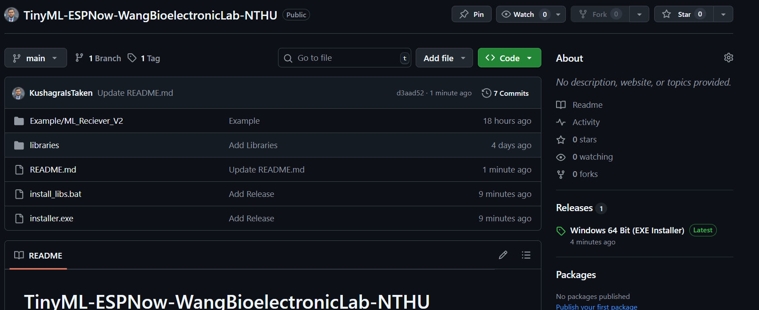
How to setup the modified libraries
Open My Github Repository at :
https://github.com/KushagraIsTaken/TinyML-ESPNow-WangBioelectronicLab-NTHU/tree/main

Slide 31
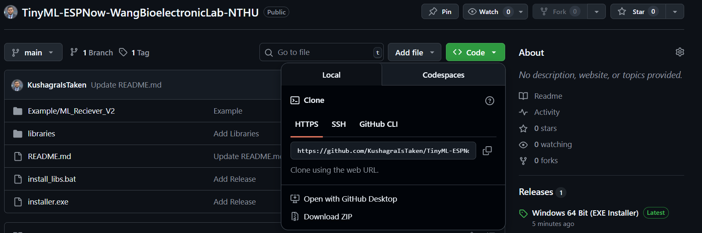

Slide 32
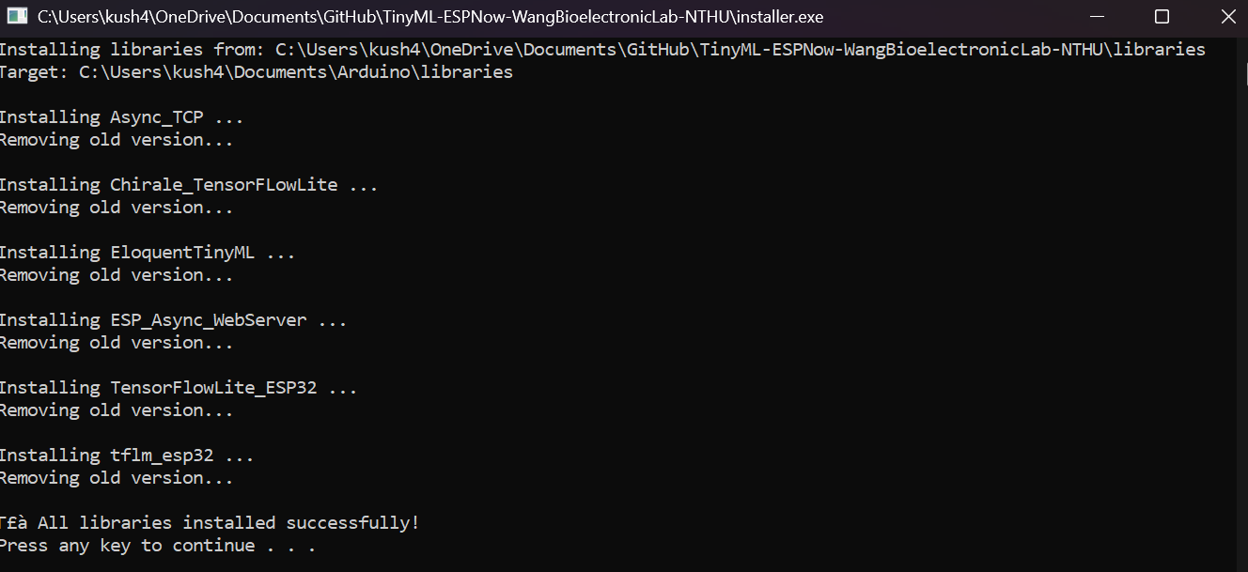
How to setup the modified libraries (Contd.)
Once you have the zip downloaded. Unzip it and click “installer.exe” .
The output should be like this
We are done here ☺ Libraries are installed
If Prompted for Password it is : nthuwanglab

Slide 33
[IMP] Restrictions for TFLite
TFLite exclusively supports TensorFlow models. Models built with other frameworks like scikit-learn, PyTorch, XGBoost, or traditional ML libraries cannot be directly converted to TFLite.You cannot convert sklearn models or other non-TF models to TFLite without rewriting or retraining in TensorFlow.

Slide 34
Example : Implementing MLP on ESP-32
Link to the colab notebook for reference : https://colab.research.google.com/drive/1MUY4l75NXSAmEGvUpXHn_NcQhquOgCge?usp=sharing
After you are done training your model, you need to save it as a TFLite model. You can use this code to do it !
import tensorflow as tf
# Convert the trained Keras model to TensorFlow Lite format
converter = tf.lite.TFLiteConverter.from_keras_model(model)
tflite_model = converter.convert()
# Save the TensorFlow Lite model to a file
with open('mlp_model.tflite', 'wb') as f:
f.write(tflite_model)
print("TensorFlow Lite model saved as 'mlp_model.tflite'")

Slide 35
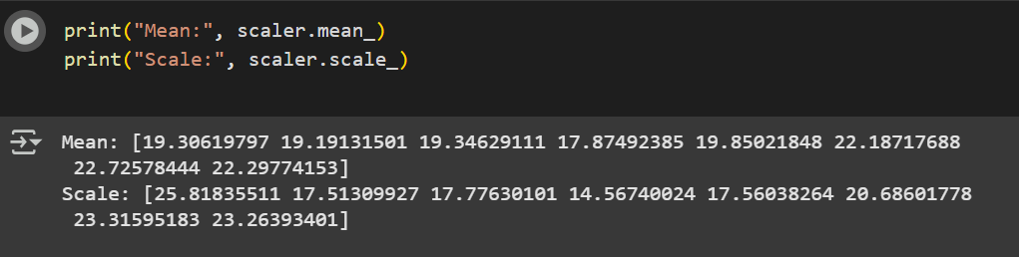
Implementing MLP on ESP-32 (Contd.)
Now you have to convert .tflite file to .h (Header file) as we code using C/C++ in ESP32
You may use this command on colab (Remove the ! If executing on a linux terminal locally)
!xxd -i mlp_model.tflite > mlp_model.h
If you have used Scaling of Data. Don’t forget to note you Scaler (Mean & Scale)

Slide 36
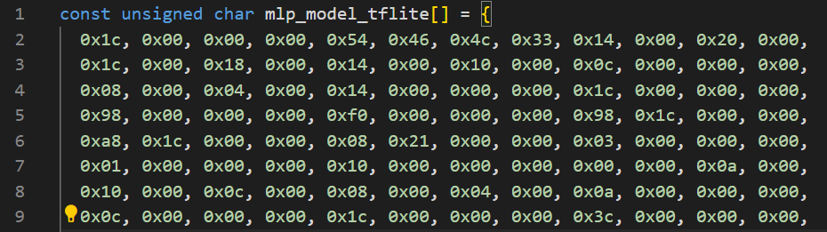
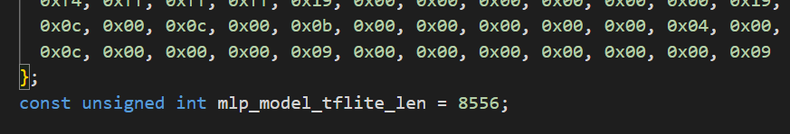
Implementing MLP on ESP-32 (Contd.)
Now Download the .tflite (For Future Reference) and .h file to you PC Locally and keep them safe. Open the .h file it should like this :

Slide 37
Implementing MLP on ESP-32 (Contd.)
If the .h file doesn’t look like the one in the previous slides. Feel free to add the words highlighted in blue to complete the model file. Once you are done open a new Arduino project.
Go to sketch>Add File> Now select the .h file that you just madde
Well Done ! .h file is now integrated with your project. You may check this by going to the project folder the Arduino Sketch (*.ino) and the Header file (*.h) should be in the same directory.

Slide 38
Implementing MLP on ESP-32 (Contd.)
Starting with headers of the Arduino Sketch. We need to import the libraries and that file.
#include "mlp_model.h"
#include <tflm_esp32.h>
#include <eloquent_tinyml.h>
<xxx> : Represent a Library
" xxx " : Represent a file
Strict Order Otherwise, you will encounter an error

Slide 39
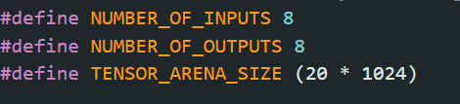
Implementing MLP on ESP-32 (Contd.)
Define the number of inputs, outputs and tensor arena size
Tensor arena size = memory reserved for running the TinyML model's tensors and intermediate data during inference. It’s okay to keep this value constant every time

Slide 40
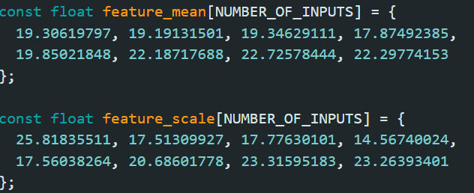
Implementing MLP on ESP-32 (Contd.)
Remember the scaling values we took in Slide 25. They come back here. You need to enter them in the code like this

Slide 41
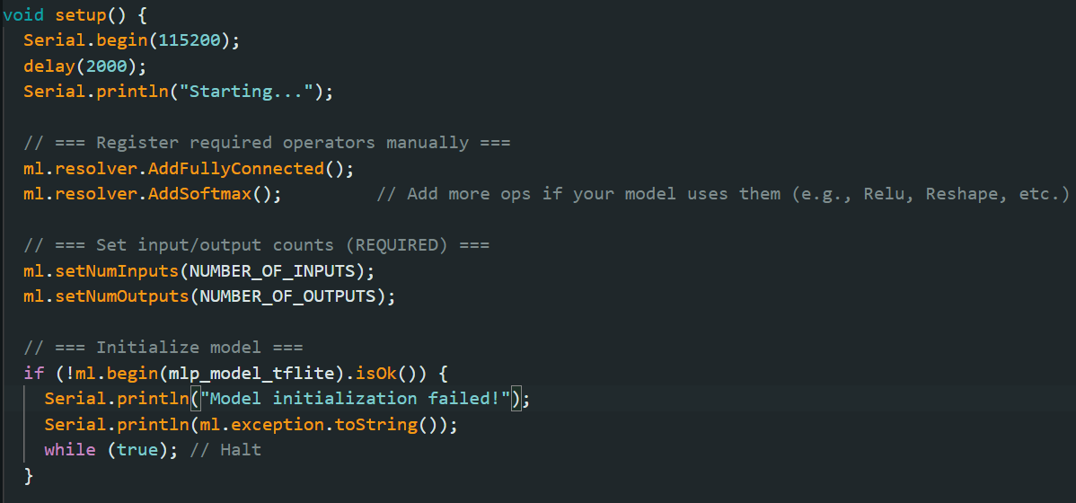
Implementing MLP on ESP-32 (Contd.)
Now initialize the layers in Setup Loop
Manually registers the ML operators that your model uses with the TensorFlow Lite Micro interpreter.
Without this, the interpreter won’t know how to execute these layers.
Explicitly tells the model wrapper how many inputs and outputs to expect.
This is mandatory to configure the input/output buffers correctly.

Slide 42
Example Implementation
An Example Implementation is present on my github repo : https://github.com/KushagraIsTaken/TinyML-ESPNow-WangBioelectronicLab-NTHU/tree/main/Example/ESP32_InferenceLogic
All the codes are easy to generate via LLMs like ChatGPT, Gemini. You may give the code written by me as context and ask it to modify it

Slide 43
Example – ESP Now + ML Inference
What does this code do ?
Takes input from Sender ESP-32 via “Serial Input” ( Can be substituted with analog input). Sends data via ESP-Now to Receiver ESP-32. Reciever ESP-32 gets the data. Runs the inference on the ML Model and then Give the prediction and does the gesture

Slide 44
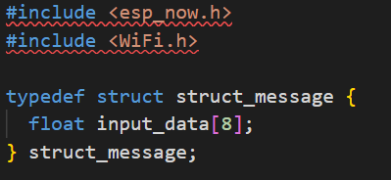
Sender Side Code
Including Necessary Libraries for sending the input Defining the shape and type of data needs to be sent. Float Array of Size 8 in our case (B’coz 8 EMG Signals)
Adding Reciever Mac Address as explained in Slide 13

Slide 45
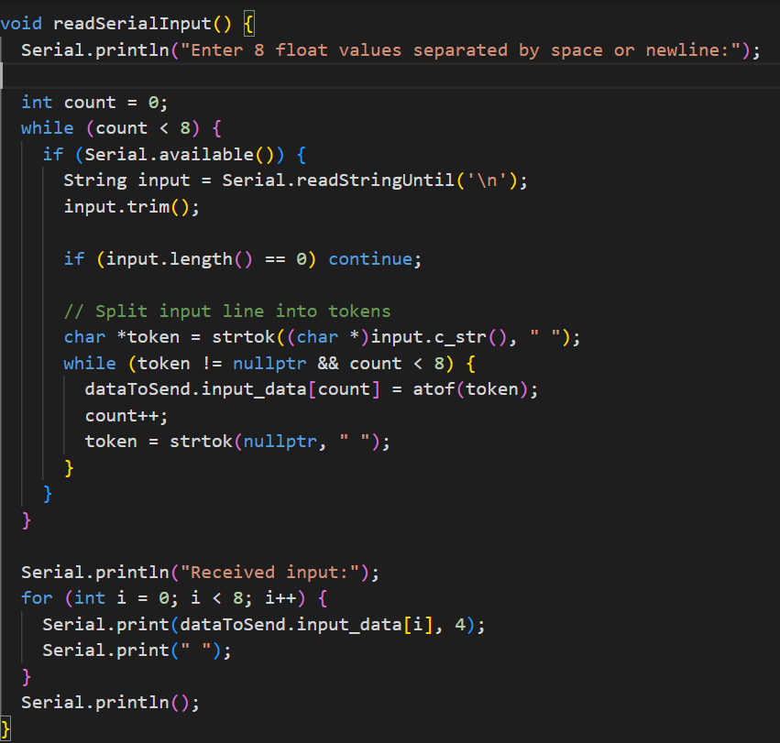
Sender Side Code (Contd.)
Reading Serial Input from Serial Monitor and Spliting them into tokens by separating them with the delimiter
Again printing the data to serial monitor to ensure correct data is written

Slide 46
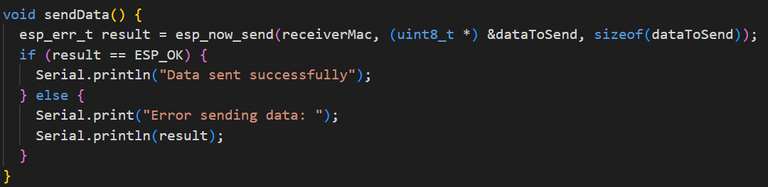
Sender Side Code (Contd.)
Sending Data Code using ESP-Now as shown on Slide 16

Slide 47
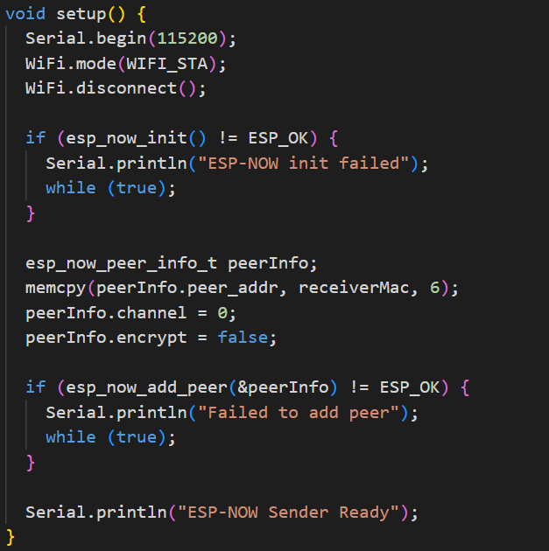
Sender Side Code (Contd.)
Setup Function
This block sets up the peer (receiver) information for ESP-NOW.
First, a peerInfo struct of type esp_now_peer_info_t is created.
Then the receiver’s MAC address (6 bytes) is copied into peerInfo.peer_addr, telling the ESP32 which device to talk to.
The communication channel is set to 0, meaning it will use the current WiFi channel by default.
Finally, peerInfo.encrypt = false disables encryption, so the data is sent in plain text.

Slide 48
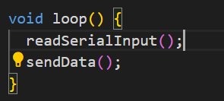
Sender Side Code (Contd.)
Loop Function

Slide 49
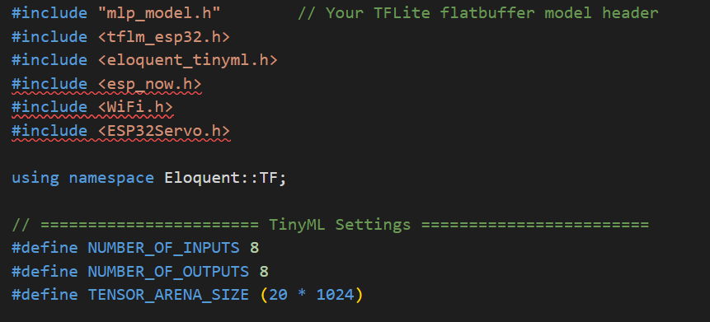
Receiver Side Code
Including the MLP Header File, The necessary Libraries and defining the number of inputs, outputs and tensor_arena_size ?

Slide 50
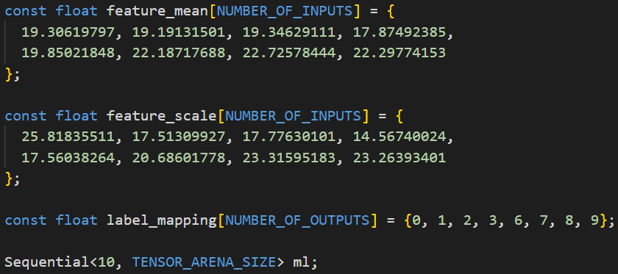
Receiver Side Code (Contd.)
Defining the feature_mean and feature_scale that we took from the training notebook as shown in Slide 25

Slide 51
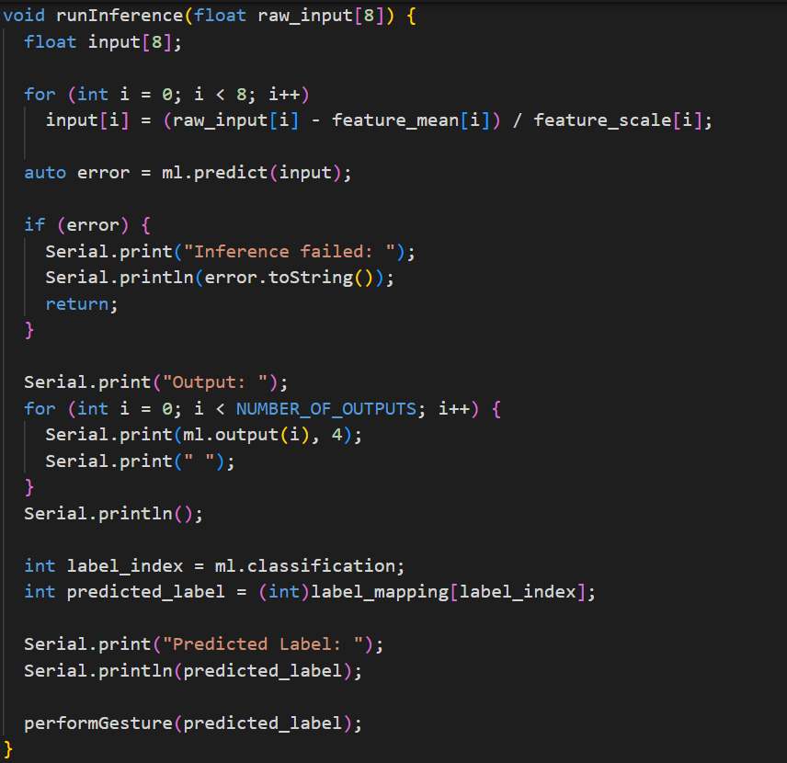
Receiver Side Code (Contd.)
This function runInference takes in an array of 8 raw input values and prepares them for a machine learning model.
First, it normalizes each input using feature_mean and feature_scale so the data matches the model’s training conditions.
Then it calls ml.predict(input) to run inference;
if prediction fails, it prints the error and exits. If successful, it prints all model output values (looping through NUMBER_OF_OUTPUTS).
Next, it gets the most likely class index from ml.classification, maps it to a label using label_mapping, and prints the predicted label.
Finally, it calls performGesture(predicted_label) to trigger some action based on that prediction.

Slide 52
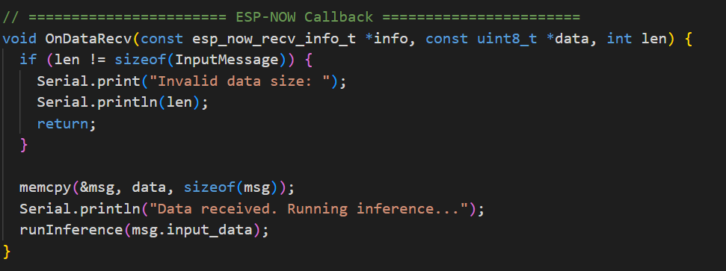
Receiver Side Code (Contd.)
Data Receiving Logic using ESP-Now
The rest of the code is the same as we would write for controlling the hand module

Slide 53
Thank You :)
Kushagra Agrawal
https://linktr.ee/kush4409 kush4409@gmail.com | kushagra.agrawal@ieee.org
https://www.linkedin.com/in/kushagra-agrawal-51a3121ab
+91 87802 26117
Drop In for any queries (Or Just to say Hi)

